Slide 1
Directly reconstructing PCAs of heterogeneous particles from cryo-EM images
Hemant D. Tagare, Alp Kucukelbir, Fred J. Sigworth, Hongwei Wang, Murali Rao
2021/4/20 陳慶豐

Slide 2
Outline
Introduction
Model formulation
Methodology
Likelihood
Expectation
Q-function
Maximization
Results
Non-iterative form
Multilinear form

Slide 3
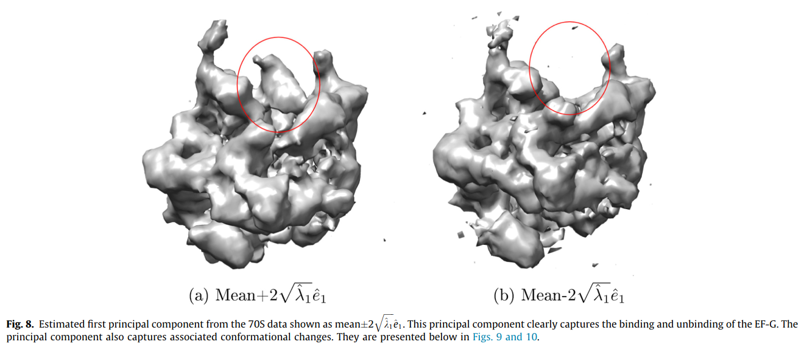
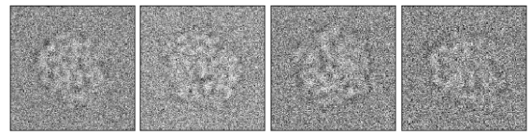
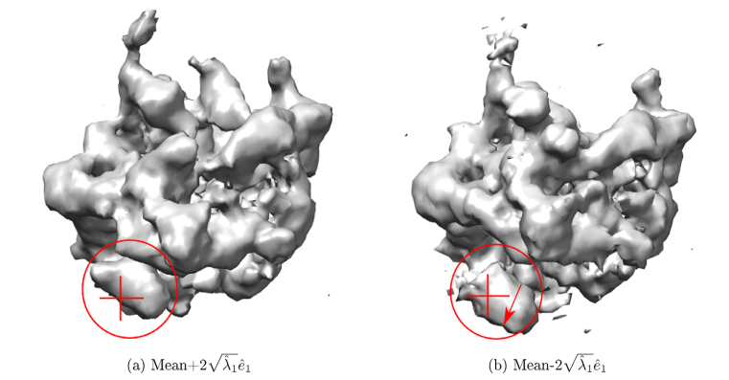
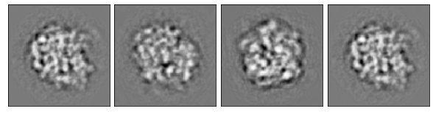
Introduction
3D principal component reconstruction
2D principal component denoising

Slide 4
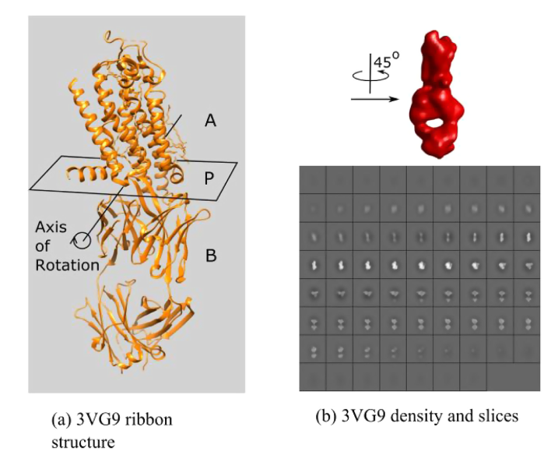






Model for heterogeneous particle
Define $s$ as a random variable on 3d space, that is $s\left(u\right)$ is a random variable at point $u$in 3d space
( $V×V×V$ or $V^{3}×1$ ). The mean:
at $u$, and the covariance $Σ_{s}$ is a deterministic function of any pair of point $u, v$ in 3d, with
$$μ_{s}\left(u\right)=𝔼\left[s\left(u\right)\right]$$
$$Σ_{s}\left(u,v\right)=𝔼\left[\left(s\left(u\right)−μ_{s}\left(u\right)\right)\left(s\left(v\right)−μ_{s}\left(v\right)\right)\right]$$
For discrete space $V^{3}×1$, we have:
$μ_{s}∈ℝ^{V^{3}×1}$, $Σ_{z}∈ℝ^{V^{3}×V^{3}}$
PCA model:
$$s=μ_{s}+z^{1}μ_{1}+z^{2}μ_{2}+…+z^{n}μ_{n}$$
$$=μ_{s}+μz$$

Slide 5



Model for noisy image
Image model:
=>
by subtracting the mean $μ_{s}$ we get
Where $ϵ∼N\left(0, σ_{j}I\right)$
$$I_{j}=A_{j}s+ϵ_{j}=A_{j}\left(μ_{s}+μz_{j}\right)+ϵ_{j}, j=1…N$$
$$I_{j}−A_{j}μ_{s}=A_{j}\left(μz_{j}\right)+ϵ_{j}, j=1…N$$
$$I_{j}=A_{j}\left(μz_{j}\right)+ϵ_{j}$$

Slide 6

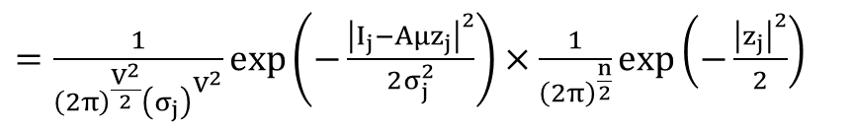

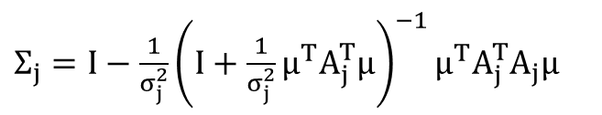
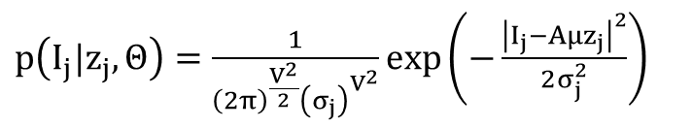
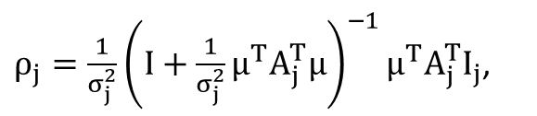
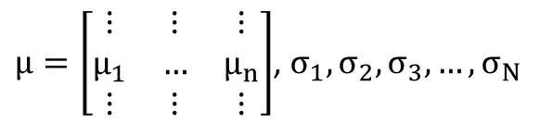
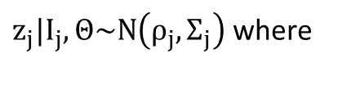
Methodology
By observing the above formulation:
We can see that all variables we want to find is:
The author solves this problem iteratively. I.e.
They first assume$μ_{1},μ_{2},…,μ_{n−1}$are known,
then want to find $μ_{n}$.
We collect all parameters in $Θ=\left(μ_{n}, σ_{1},σ_{2},..σ_{n}\right)$.
and add prior: $\log\left(p\left(μ_{n}\right)\right)∝−γ{\left|∇μ_{n}\right|}^{2}$
Likelihood:
$$I_{j}=A_{j}\left(μz_{j}\right)+ϵ_{j}$$
$p\left(I_{j}|z_{j},Θ\right)=\frac{1}{{\left(2π\right)}^{\frac{V^{2}}{2}}{\left(σ_{j}\right)}^{V^{2}}}\exp\left(−\frac{{\left|I_{j}−Aμz_{j}\right|}^{2}}{2σ_{j}^{2}}\right)$
$$p\left(I_{j},z_{j}|Θ\right)=p\left(I_{j}|z_{j},Θ\right)p\left(z_{j}|Θ\right)=p\left(I_{j}|z_{j},Θ\right)p\left(z_{j}\right)$$
$μ=\left[\begin{matrix}⋮ & ⋮ & ⋮ \\ μ_{1} & … & μ_{n} \\ ⋮ & ⋮ & ⋮\end{matrix}\right]$, $σ_{1},σ_{2},σ_{3},…,σ_{N}$
$=\frac{1}{{\left(2π\right)}^{\frac{V^{2}}{2}}{\left(σ_{j}\right)}^{V^{2}}}\exp\left(−\frac{{\left|I_{j}−Aμz_{j}\right|}^{2}}{2σ_{j}^{2}}\right)×\frac{1}{{\left(2π\right)}^{\frac{n}{2}}}\exp\left(−\frac{{\left|z_{j}\right|}^{2}}{2}\right)$
We want to find $p\left(z_{j}|I_{j},Θ\right)$ for Expectation step and get:
$z_{j}|I_{j},Θ\sim N\left(ρ_{j}, Σ_{j}\right)$ where
$ρ_{j}=\frac{1}{σ_{j}^{2}}{\left(I+\frac{1}{σ_{j}^{2}}μ^{T}A_{j}^{T}μ\right)}^{−1}μ^{T}A_{j}^{T}I_{j}$,
$Σ_{j}=I−\frac{1}{σ_{j}^{2}}{\left(I+\frac{1}{σ_{j}^{2}}μ^{T}A_{j}^{T}μ\right)}^{−1}μ^{T}A_{j}^{T}A_{j}μ$

Slide 7
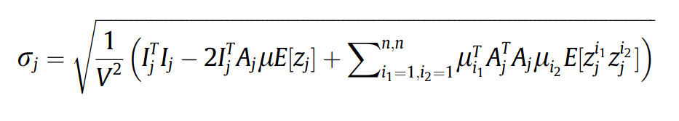

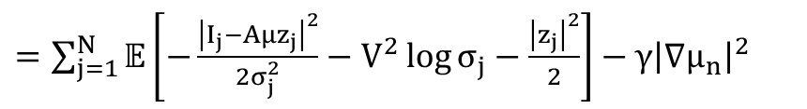

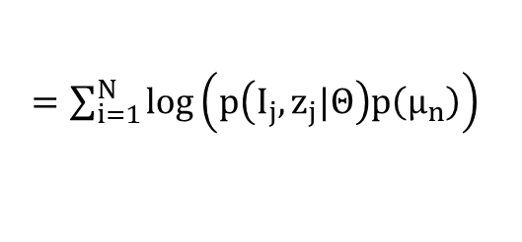
Q function and Maximization
$$Q\left(Θ, Θ^{\left[k\right]}\right)=𝔼_{z|I}\log\left(p\left(I_{j},z_{j}|Θ\right)p\left(μ_{n}\right)\right)$$
$=\sum_{i=1}^{N}{\log\left(p\left(I_{j},z_{j}|Θ\right)p\left(μ_{n}\right)\right)}$
$=\sum_{j=1}^{N}{𝔼\left[−\frac{{\left|I_{j}−Aμz_{j}\right|}^{2}}{2σ_{j}^{2}}−V^{2}\log{σ_{j}}−\frac{{\left|z_{j}\right|}^{2}}{2}\right]}−γ{\left|∇μ_{n}\right|}^{2}$
Then drop all terms that do not depends on $Θ,$ gives
$=\sum_{j=1}^{N}{\left(\frac{1}{σ_{j}^{2}}\right)}\left\{{\left(A_{j}^{T}I_{j}\right)}^{T}μ_{n}𝔼\left[z_{j}^{n}\right]−\sum_{i<n}{μ_{i}^{T}A_{j}^{T}A_{j}μ_{n}𝔼\left[z_{j}^{i}z_{j}^{n}\right]}−\frac{1}{2}μ_{n}^{T}A_{j}^{T}A_{j}μ_{n}𝔼\left[{\left(z_{j}^{n}\right)}^{2}\right]\right\}−γ{\left|∇μ_{n}\right|}^{2}$
$∇_{μ_{n}}Q= \sum_{j=1}^{N}{\left(\frac{1}{σ_{j}^{2}}\right)}\left\{{\left(A_{j}^{T}I_{j}\right)}^{T}𝔼\left[z_{j}^{n}\right]−\sum_{i=1}^{n}{A_{j}^{T}A_{j}μ_{i}𝔼\left[z_{j}^{i}z_{j}^{n}\right]}\right\}−2γ∇^{2}μ_{n}$
Then project $∇_{μ_{n}}Q$ on to subspace orthogonal to $span\left(μ_{1},μ_{2},…,μ_{n−1}\right)$ gives:
$P\left(∇_{μ_{n}}Q\right)=∇_{μ_{n}}Q−\sum_{j=1}^{N}{\frac{μ_{j^{T}}}{\left|μ_{j}\right|}∇_{μ_{n}}Q}$ (Maximization)

Slide 8
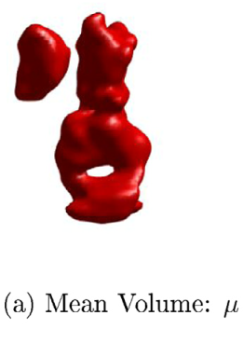
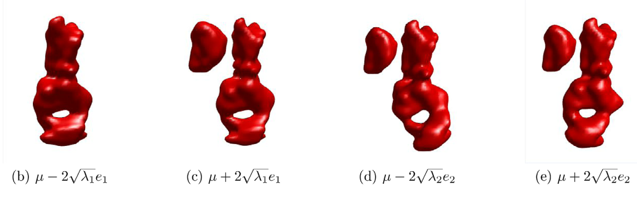
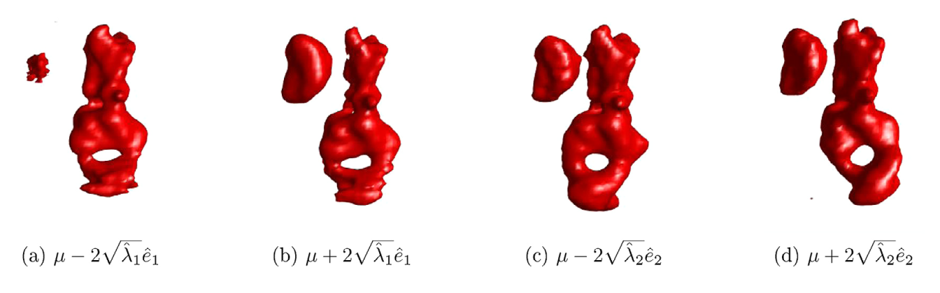
Results
Stimulated
Reconstructed

Slide 9
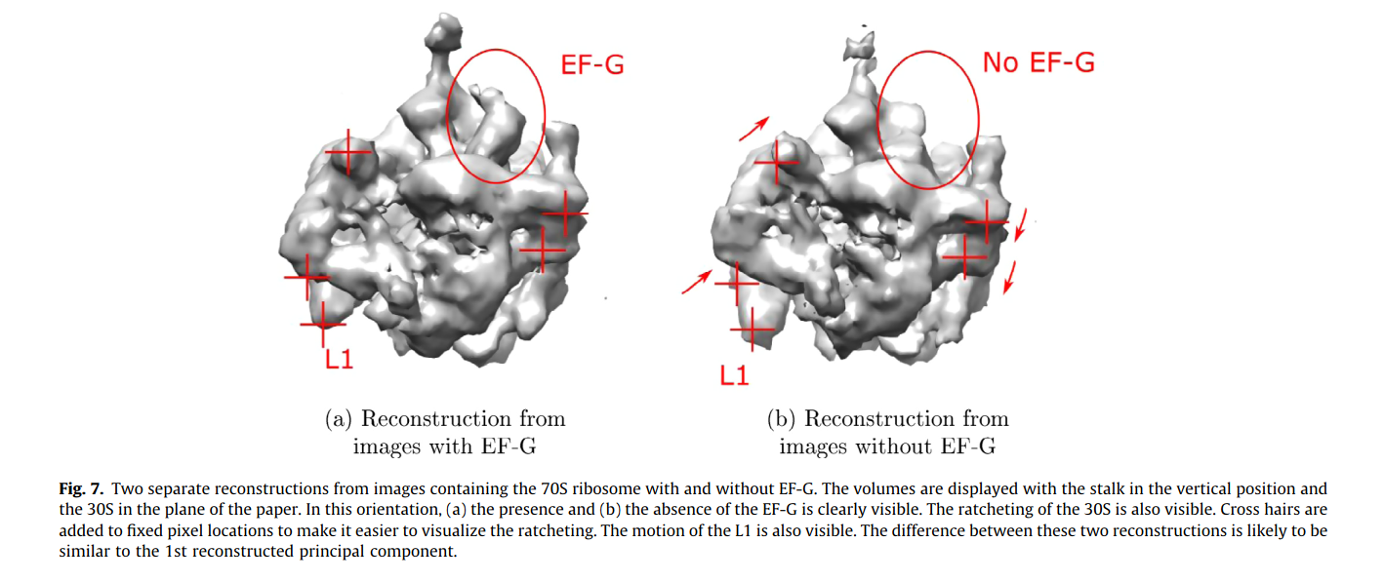
Results

Slide 10
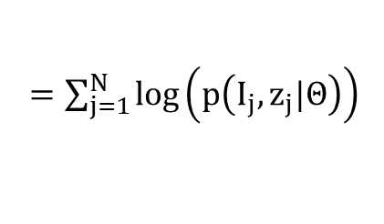
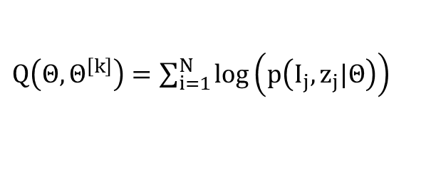
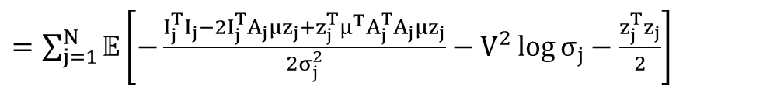
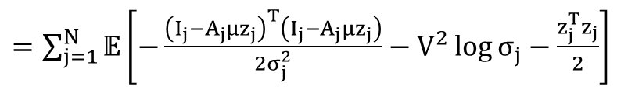
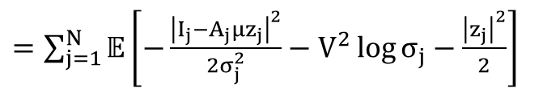
Q-function for non-iterative approach
$Q\left(Θ, Θ^{\left[k\right]}\right)=\sum_{i=1}^{N}{\log\left(p\left(I_{j},z_{j}|Θ\right)\right)}$
$=\sum_{j=1}^{N}{\log\left(p\left(I_{j},z_{j}|Θ\right)\right)}$
$=\sum_{j=1}^{N}{𝔼\left[−\frac{{\left|I_{j}−A_{j}μz_{j}\right|}^{2}}{2σ_{j}^{2}}−V^{2}\log{σ_{j}}−\frac{{\left|z_{j}\right|}^{2}}{2}\right]}$
$=\sum_{j=1}^{N}{𝔼\left[−\frac{{\left(I_{j}−A_{j}μz_{j}\right)}^{T}\left(I_{j}−A_{j}μz_{j}\right)}{2σ_{j}^{2}}−V^{2}\log{σ_{j}}−\frac{z_{j}^{T}z_{j}}{2}\right]}$
$=\sum_{j=1}^{N}{𝔼\left[−\frac{I_{j}^{T}I_{j}−2I_{j}^{T}A_{j}μz_{j}+z_{j}^{T}μ^{T}A_{j}^{T}A_{j}μz_{j}}{2σ_{j}^{2}}−V^{2}\log{σ_{j}}−\frac{z_{j}^{T}z_{j}}{2}\right]}$
$=\sum_{j=1}^{N}{\left\{−\frac{I_{j}^{T}I_{j}−2I_{j}^{T}A_{j}μ𝔼\left[z_{j}\right]+tr\left(A_{j}μ𝔼\left[z_{j}z_{j}^{T}\right]μ^{T}A_{j}^{T}\right) }{2σ_{j}^{2}}−V^{2}\log{σ_{j}}−\frac{tr\left(𝔼\left[z_{j}z_{j}^{T}\right]\right)}{2}\right\}}$
$=\sum_{j=1}^{N}{\left\{−\frac{I_{j}^{T}I_{j}−2tr\left(𝔼\left[z_{j}\right]I_{j}^{T}A_{j}μ\right)+tr\left(A_{j}μ𝔼\left[z_{j}z_{j}^{T}\right]μ^{T}A_{j}^{T}\right) }{2σ_{j}^{2}}−V^{2}\log{σ_{j}}−\frac{tr\left(𝔼\left[z_{j}z_{j}^{T}\right]\right)}{2}\right\}}$

Slide 11
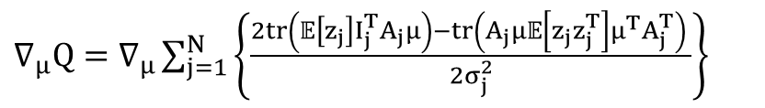

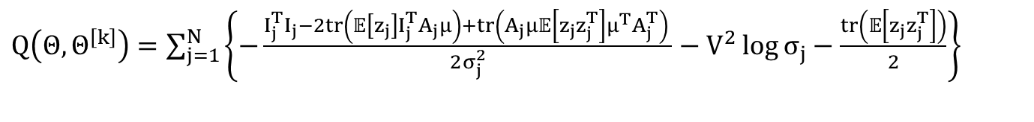
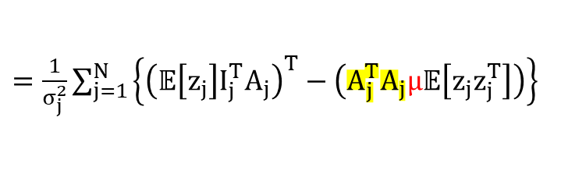
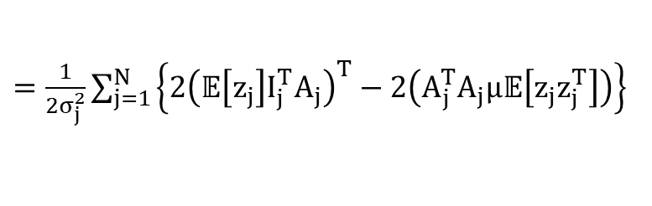
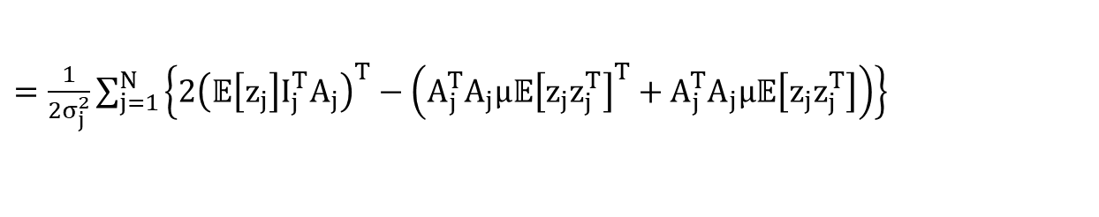
Q-function for non-iterative approach
$Q\left(Θ, Θ^{\left[k\right]}\right)=\sum_{j=1}^{N}{\left\{−\frac{I_{j}^{T}I_{j}−2tr\left(𝔼\left[z_{j}\right]I_{j}^{T}A_{j}μ\right)+tr\left(A_{j}μ𝔼\left[z_{j}z_{j}^{T}\right]μ^{T}A_{j}^{T}\right) }{2σ_{j}^{2}}−V^{2}\log{σ_{j}}−\frac{tr\left(𝔼\left[z_{j}z_{j}^{T}\right]\right)}{2}\right\}}$
Which gives
$∇_{μ}Q=∇_{μ}\sum_{j=1}^{N}{\left\{\frac{2tr\left(𝔼\left[z_{j}\right]I_{j}^{T}A_{j}μ\right)−tr\left(A_{j}μ𝔼\left[z_{j}z_{j}^{T}\right]μ^{T}A_{j}^{T}\right) }{2σ_{j}^{2}}\right\}}$
$=\frac{1}{2σ_{j}^{2}}\sum_{j=1}^{N}{\left\{2{\left(𝔼\left[z_{j}\right]I_{j}^{T}A_{j}\right)}^{T}−\left(A_{j}^{T}A_{j}μ𝔼{\left[z_{j}z_{j}^{T}\right]}^{T}+A_{j}^{T}A_{j}μ𝔼\left[z_{j}z_{j}^{T}\right]\right)\right\}}$
$=\frac{1}{2σ_{j}^{2}}\sum_{j=1}^{N}{\left\{2{\left(𝔼\left[z_{j}\right]I_{j}^{T}A_{j}\right)}^{T}−2\left(A_{j}^{T}A_{j}μ𝔼\left[z_{j}z_{j}^{T}\right]\right)\right\}}$
$=\frac{1}{σ_{j}^{2}}\sum_{j=1}^{N}{\left\{{\left(𝔼\left[z_{j}\right]I_{j}^{T}A_{j}\right)}^{T}−\left(A_{j}^{T}A_{j}μ𝔼\left[z_{j}z_{j}^{T}\right]\right)\right\}}$
Since $A_{j}^{T}A_{j}$ term, we can’t have close form solution for $μ$.
But we can use gradient descent to optimize $μ$.

Slide 12












Multilinear form
Original form (vector form)
$$s=μ_{s}+z^{1}μ_{1}+z^{2}μ_{2}+…+z^{n}μ_{n}$$
$$=μ_{s}+μz$$
Multilinear form (tensor form)
$s=μ_{s}+z×_{1}U_{1}×_{2}U_{2}$ $×_{3}U_{3}$
$⇒$
$s=z×_{1}U_{1}×_{2}U_{2}$ $×_{3}U_{3}$ (tensor form)
$⇒$
$s_{\left(3\right)}=U_{3} z_{\left(3\right)} {\left(U_{1}⨂U_{2}\right)}^{T}$ (matrix form)
where
$⇒$
$s,μ_{s}∈ℝ^{I_{1}×I_{2}×I_{3}}$
$\tilde{s_{\left(3\right)}}=\left(U_{1}⨂U_{2}⨂U_{3}\right)\tilde{z_{\left(3\right)}}$ (vector form)
$P∈ℝ^{P_{1}×P_{2}×P_{3}}$
$U_{i}∈ℝ^{P_{i}×I_{i}}$

Slide 13


Q-function for multilinear form
$Q\left(Θ, Θ^{\left[k\right]}\right)=\sum_{j=1}^{N}{\left\{−\frac{I_{j}^{T}I_{j}−2tr\left(𝔼\left[z_{j}\right]I_{j}^{T}A_{j}μ\right)+tr\left(A_{j}μ𝔼\left[z_{j}z_{j}^{T}\right]μ^{T}A_{j}^{T}\right) }{2σ_{j}^{2}}−V^{2}\log{σ_{j}}−\frac{tr\left(𝔼\left[z_{j}z_{j}^{T}\right]\right)}{2}\right\}}$
$\tilde{s_{\left(3\right)}}=\left(U_{1}⨂U_{2}⨂U_{3}\right)\tilde{z_{\left(3\right)}}$
Substitute $μ$ with $\left(U_{1}⨂U_{2}⨂U_{3}\right)$ and $z$ with $\tilde{z_{\left(3\right)}}$, we get:
$Q\left(Θ, Θ^{\left[k\right]}\right)=\sum_{j=1}^{N}{\left\{−\frac{I_{j}^{T}I_{j}−2tr\left(𝔼\left[{\tilde{z_{\left(3\right)}}}_{j}\right]I_{j}^{T}A_{j}\left(U_{1}⨂U_{2}⨂U_{3}\right)\right)+tr\left(A_{j}\left(U_{1}⨂U_{2}⨂U_{3}\right)𝔼\left[{\tilde{z_{\left(3\right)}}}_{j}{\tilde{z_{\left(3\right)}}}_{j}^{T}\right]{\left(U_{1}⨂U_{2}⨂U_{3}\right)}^{T}A_{j}^{T}\right) }{2σ_{j}^{2}}−V^{2}\log{σ_{j}}−\frac{tr\left(𝔼\left[{{\tilde{z_{\left(3\right)}}}_{j}\tilde{z_{\left(3\right)}}}_{j}^{T}\right]\right)}{2}\right\}}$
$Q\left(Θ, Θ^{\left[k\right]}\right)=\sum_{j=1}^{N}{\left\{−\frac{I_{j}^{T}I_{j}−2tr\left({\left(U_{1}⨂U_{2}\right)}^{T}𝔼\left[{\tilde{z_{\left(3\right)}}}_{j}\right]I_{j}^{T}A_{j}\left(U_{3}\right)\right)+tr\left(A_{j}\left(U_{3}\right)\left(U_{1}⨂U_{2}\right)𝔼\left[{\tilde{z_{\left(3\right)}}}_{j}{\tilde{z_{\left(3\right)}}}_{j}^{T}\right]{{\left(U_{1}⨂U_{2}\right)}^{T}\left(U_{3}\right)}^{T}A_{j}^{T}\right) }{2σ_{j}^{2}}−V^{2}\log{σ_{j}}−\frac{tr\left(𝔼\left[{{\tilde{z_{\left(3\right)}}}_{j}\tilde{z_{\left(3\right)}}}_{j}^{T}\right]\right)}{2}\right\}}$
$⇒$
$∇_{U_{3}}Q=$ $\frac{1}{σ_{j}^{2}}\sum_{j=1}^{N}{\left\{{\left(\left(U_{1}⨂U_{2}\right)𝔼\left[\tilde{z_{\left(3\right)}}\right]I_{j}^{T}A_{j}\right)}^{T}−\left(A_{j}^{T}A_{j}U_{3}\left(U_{1}⨂U_{2}\right)𝔼\left[{\tilde{z_{\left(3\right)}}}_{j}{\tilde{z_{\left(3\right)}}}_{j}^{T}\right]{\left(U_{1}⨂U_{2}\right)}^{T}\right)\right\}}$

Slide 14
Thanks

